Slide 1

Upper Susitna Food Pantry
Annual Report 2023
uppersusitnafoodpantry.org

Slide 2
Contents
Looking Back
Volunteers
Our Impact
Teamwork
Financials P & L

Slide 3
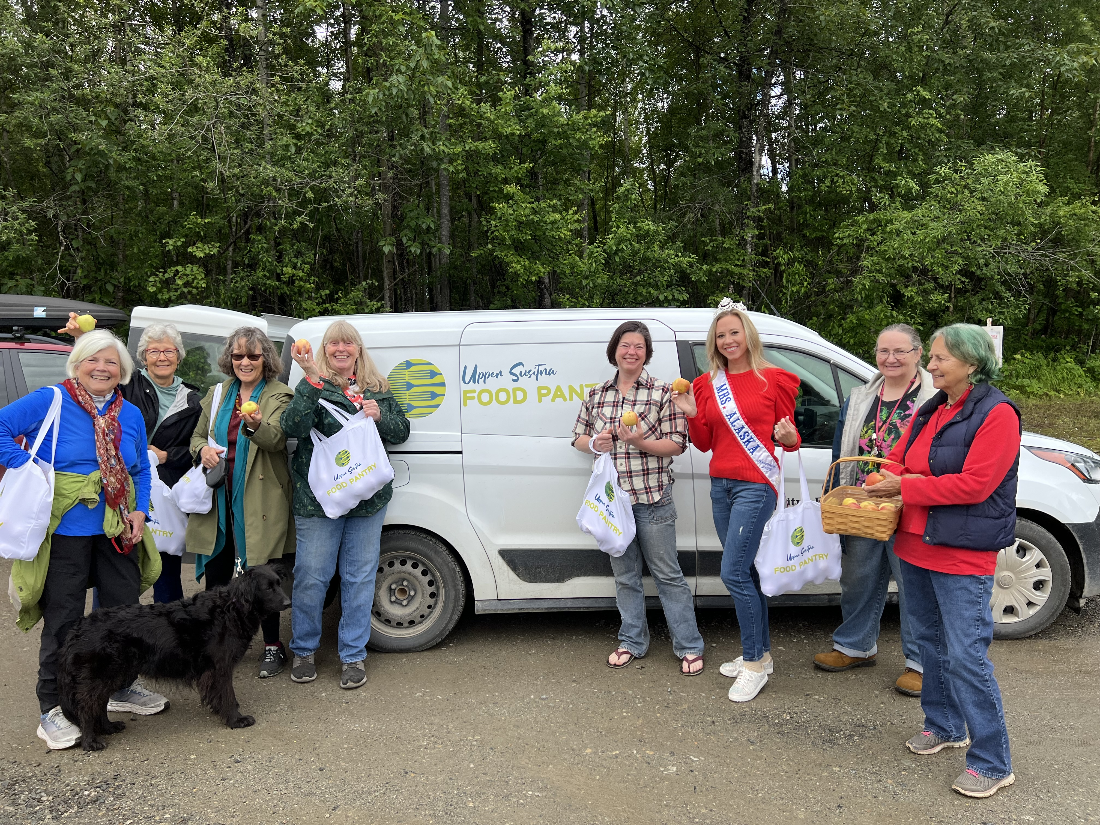
Looking Back
2023 was a busy year for the Upper Susitna Food Pantry (USFP), and that’s nothing new. The USFP serves a vast area from Willow to Trapper Creek. Our clients include families whose permanent residence is in the upper Su valley and others who are here for seasonal work.
Throughout the year our wonderful staff and volunteers work diligently to develop and implement innovative and successful programs to serve our community’s food needs. We collaborate with other community organizations, such as the Senior Center, Su Valley High School, the elementary schools and the Talkeetna Library.
While you can learn more about the pantry, our programs, projects, and events by visiting our revamped website at: https://uppersusitnafoodpantry.org/, I want to highlight two of our projects that are near and dear to my heart:
The Ripples-Reducing Isolation in Senior Populations Project (R.I.P.P.L.E.S.) not only helps provide healthy lunches to our low-income older adults, but also provides free transportation and an opportunity to eat a hot meal and socialize with their friends each week at the local senior center.
The Community Garden is a collaboration with Church on the Rock, which provides us with the space. With volunteers ranging from seniors to young children, we plant and grow a community garden that not only grows produce for hungry families in our community but also helps start the youngsters on the path of gardening for themselves.
Enjoy browsing our 2023 Annual Report, and as you digest the statistics and read about our year, feel proud that you’ve worked with us as we strive to meet our mission: To Feed the Hungry. As we say every year, we couldn’t do it without you. To all of you— whether volunteer, staff, corporate sponsor, client, or donor, thank you!
Ruth Dillard Wood Board President

Slide 4
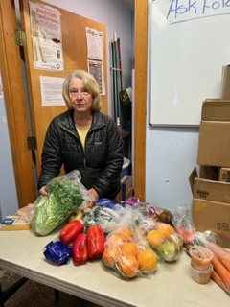
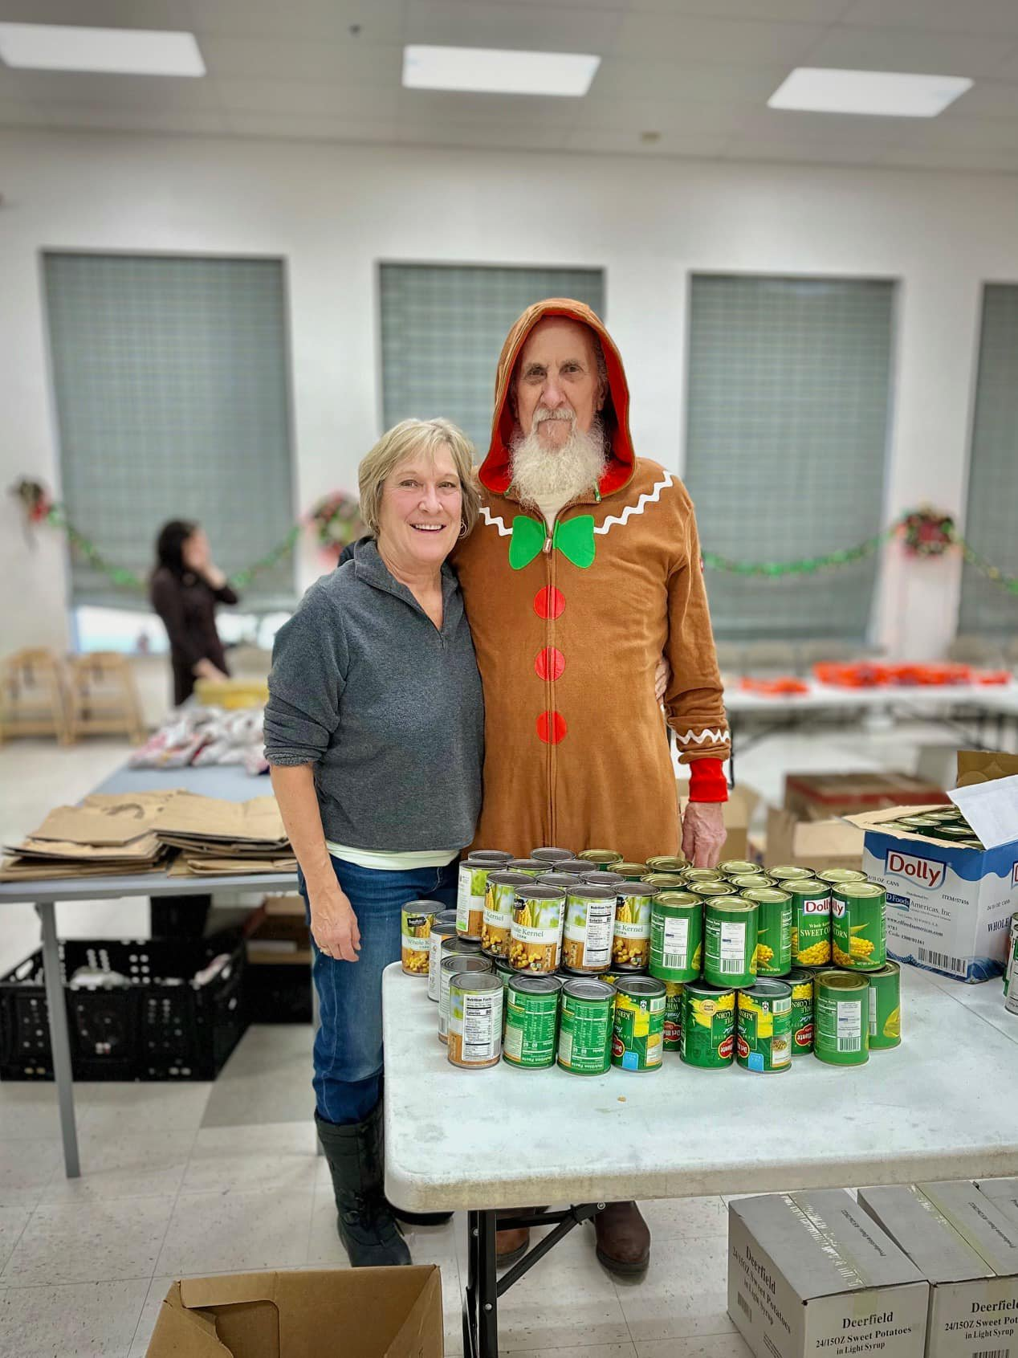
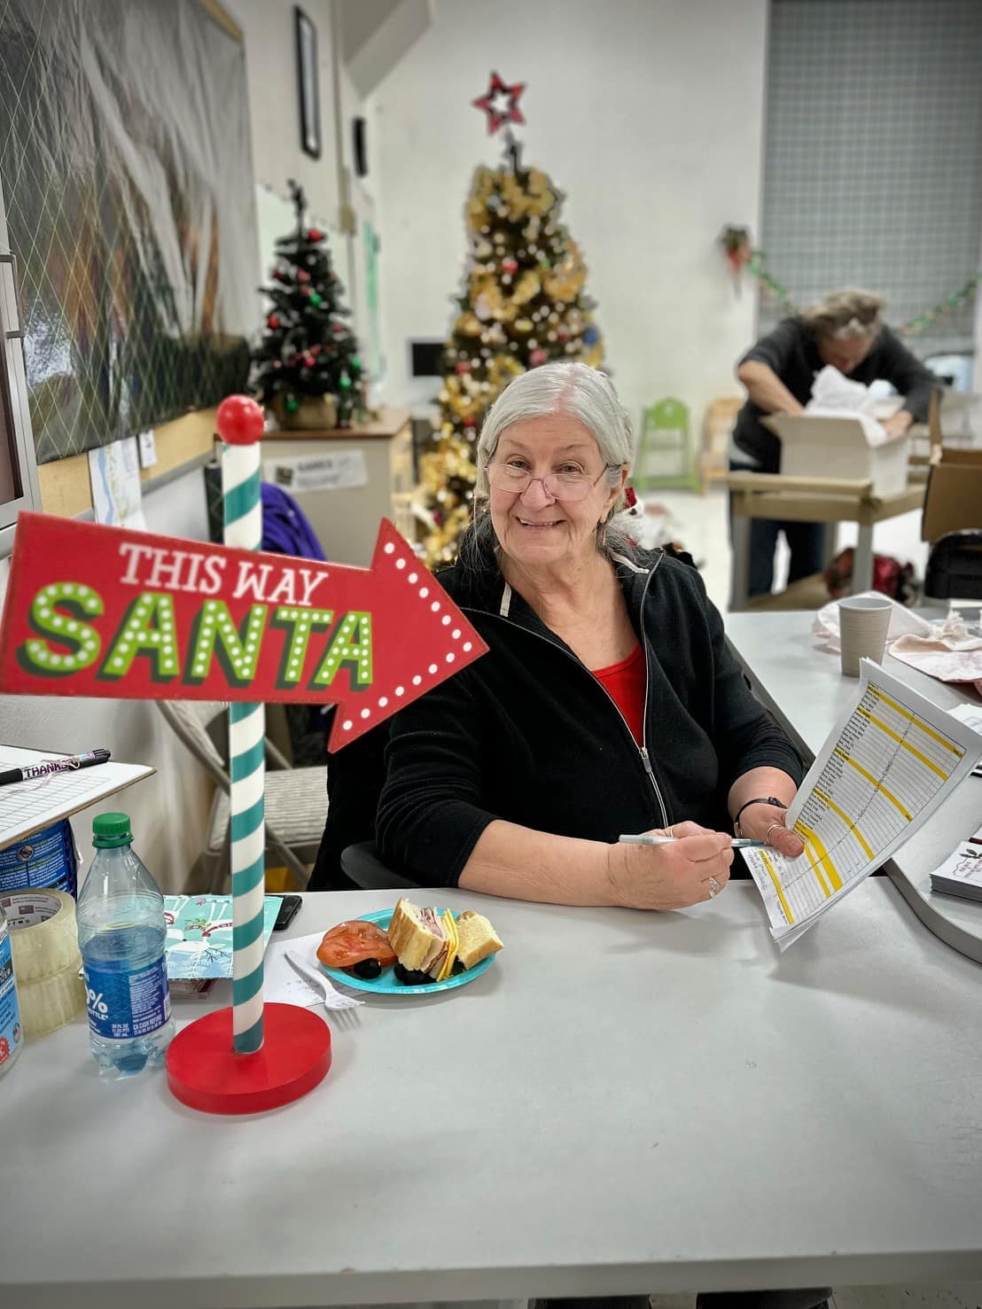
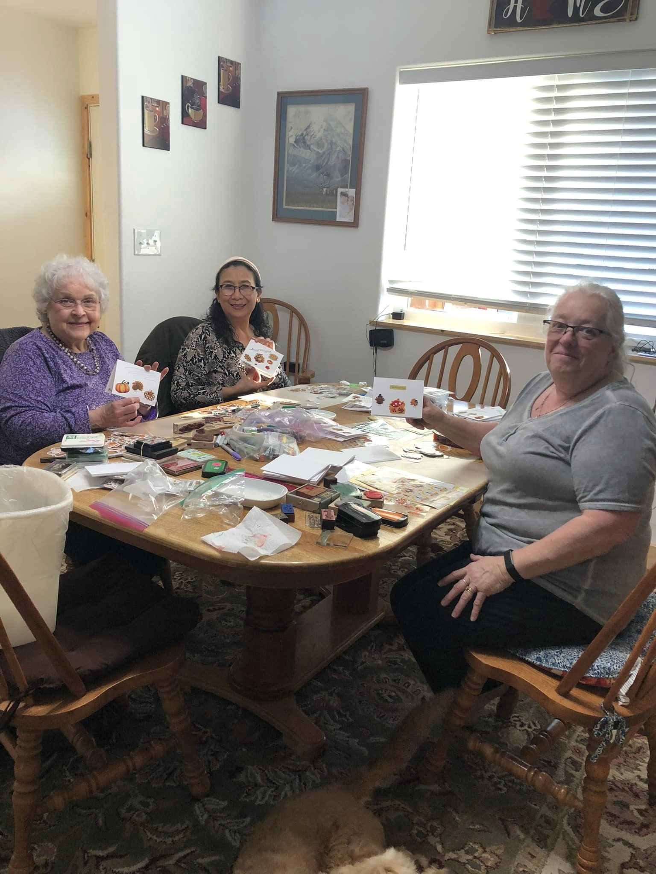
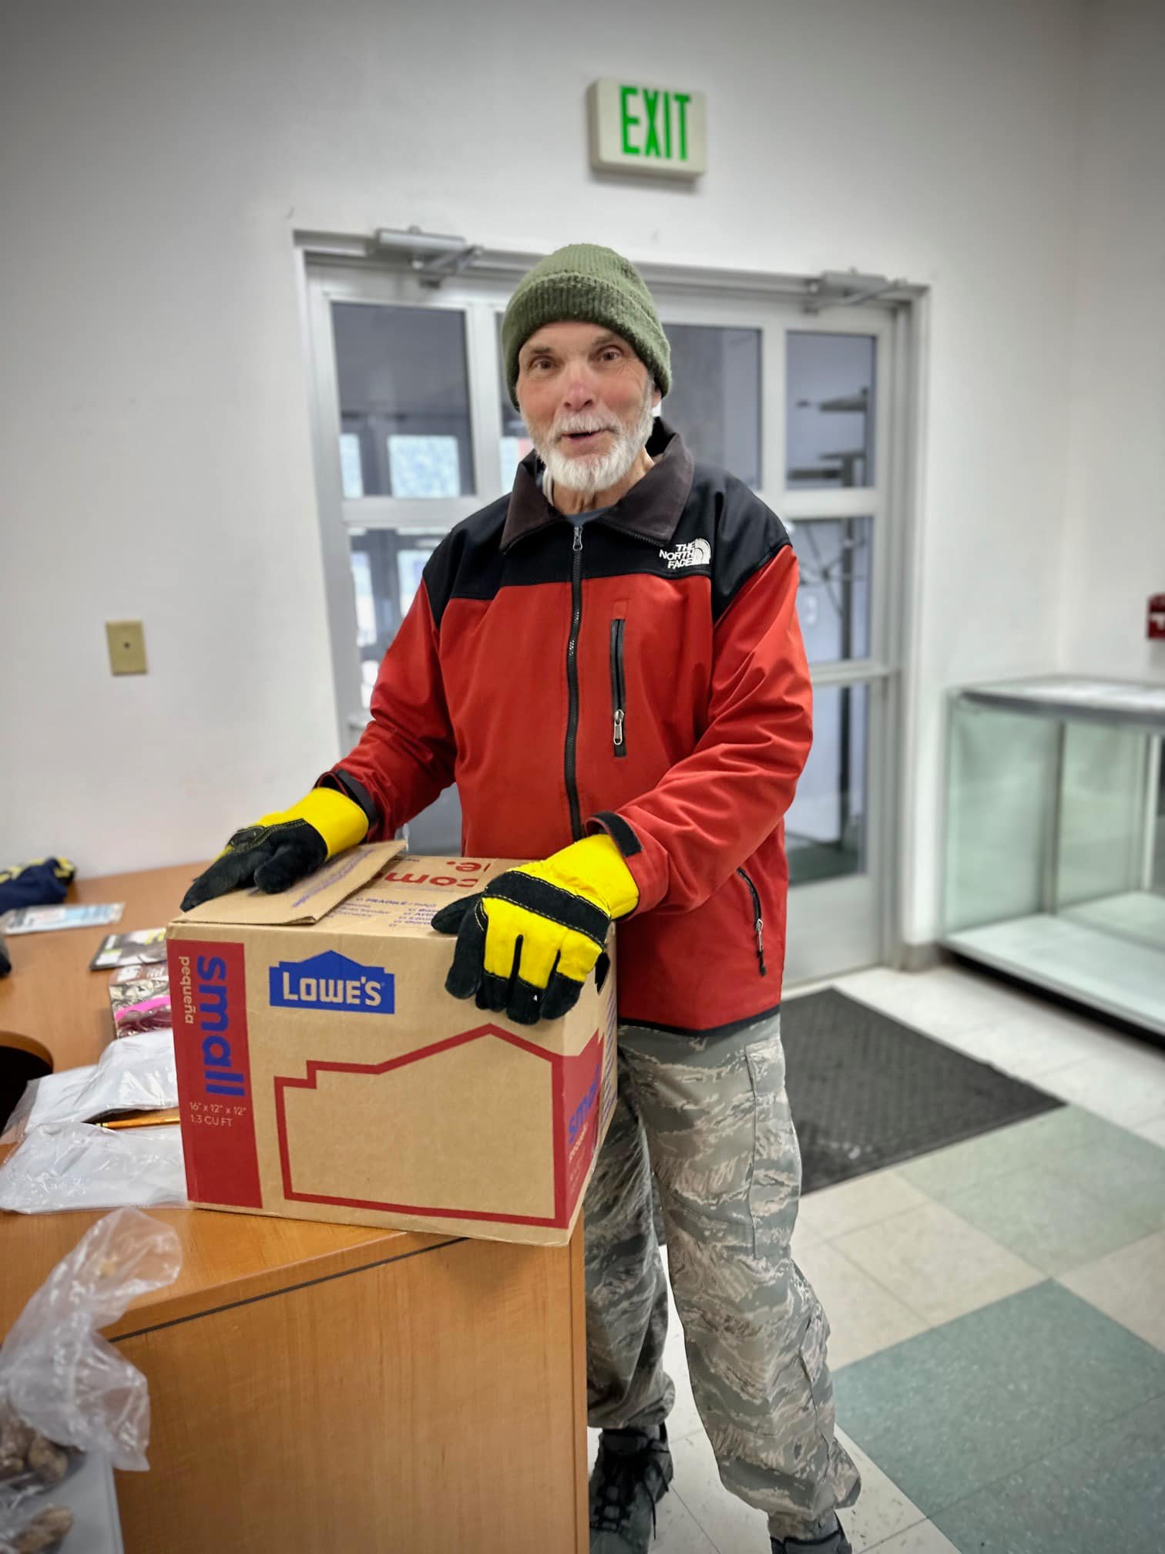
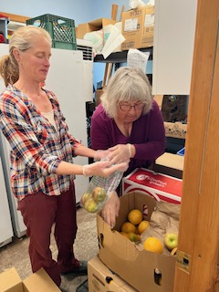
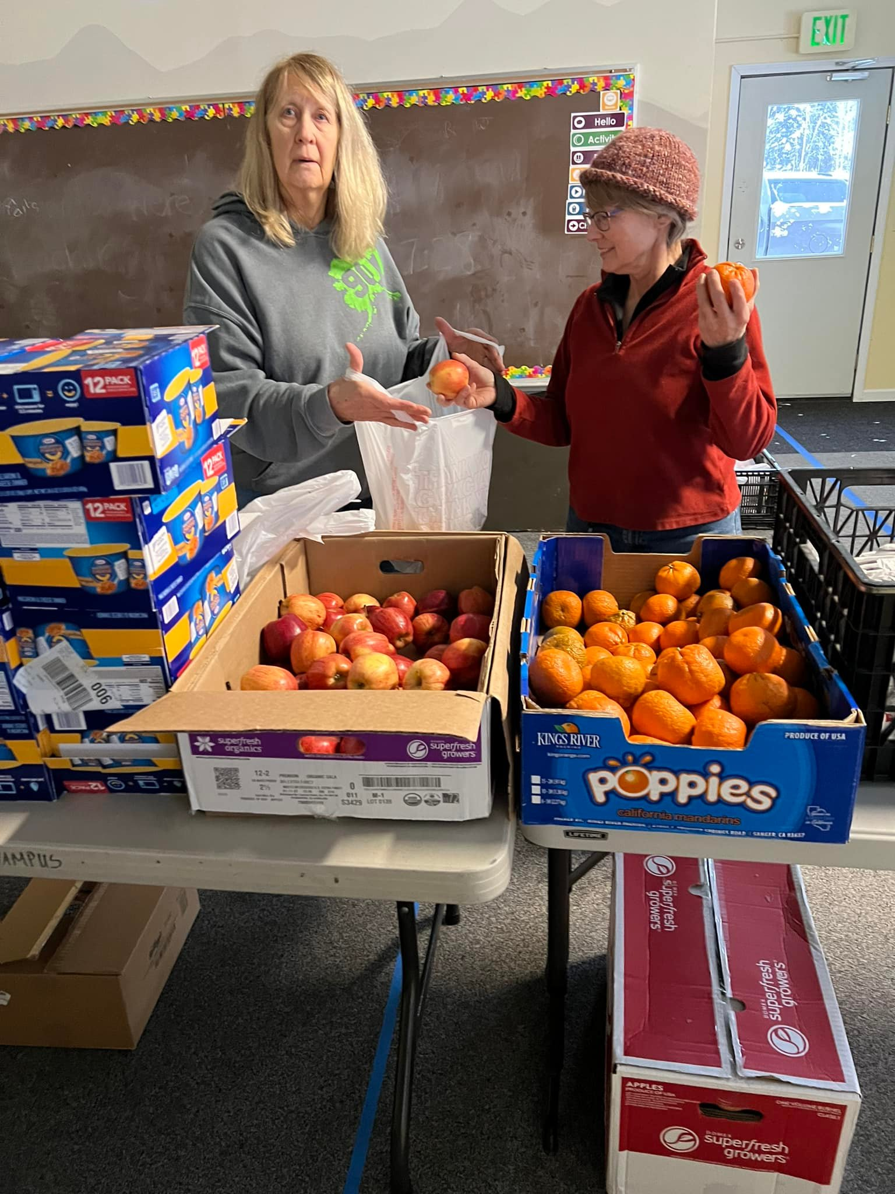
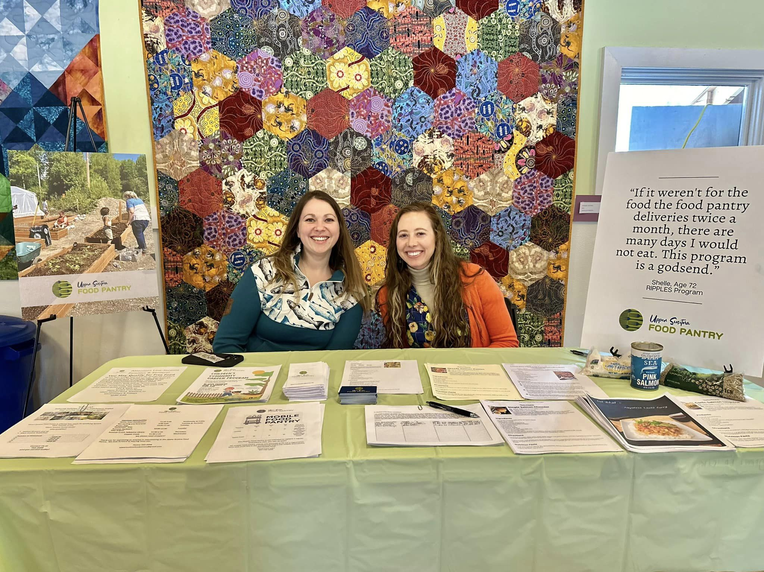
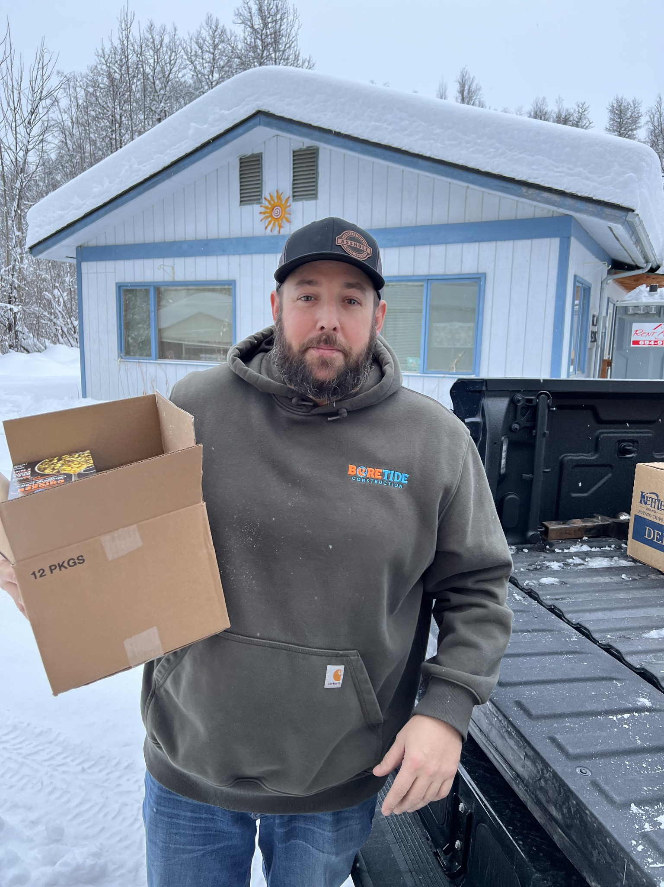
Volunteers
Community volunteers are the heart of the Food Pantry: we could not function without considerable support from the five communities we serve. Volunteers shop for food, maintain the facility, move freight, bag produce, function as board members and most visibly, work at the Food Pantry when it is open for clients to pick up food.
In 2023, community volunteers donated over 7,000 hours to the Upper Susitna Food Pantry.

Slide 5

Our Impact
2023 USFP Distributions
248,955 pounds of food
791 Summer Lunches
700 Summer Backpacks
1851 Senior Meals
160 School Break Bags
1,540 Weekend Brown Bags
192 Thanksgiving Meal Boxes
182 Christmas Meal boxes

Slide 6
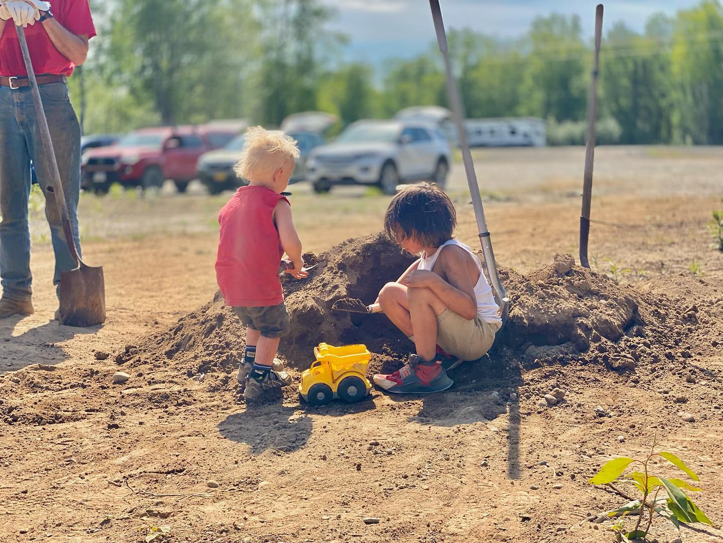
Teamwork
Staff
LouAnne Carroll-Tysdal Executive Director
Vickey McDonald Senior Program Associate
Derek McDonald Mobile Food Pantry Driver
Jeff Richards Mobile Food Pantry
Heather Christiansen BookKeeper
Board of Directors
Ruth Wood President
Alison McCullough Vice President
Becky Hrdy Secretary
Michelle Puryear Treasurer
Kathy Ernst Director
Rendel Dey Director

Slide 7
Income
Fundraising 47,834.62
Grants 192,769.00
Sustaining Donor 14,954.48
Hunger Is 581.53
Total Income
264,083.65
Expense
Community Outreach 1,227.28
Food 132,816.56
Garden Expense 1,358.88
Fuel Assistance 8,638.72
Insurance 1,835.00
License & Fees 185.60
Membership 735.00
Operations 12,793.82
Payroll 69,726.58
Personal Care 1,051.16
Travel 25.94
Utilities 6,654.95
Vehicle Expense 11,381.84
Total Expense
251.461.46
Other Income/Expense
Other Income
Bank Dividend 1,478.27
Gifts In Kind Income
Federal Food Program 93,506.23
Public Food Donation 117,707.02
Total Gifts In-Kind Income 211,213.25
Total Other Income 212,691.52
Other Expense
In-Kind Food Expense
Federal Program Food 93,506.23
In Kind Community D 117,707.02
Total In-Kind Food Expense 211,213.25
Total Other Expense 211,213.25
Net Other Income
1,476.27
Net Income
$14,080.66

